Slide 1

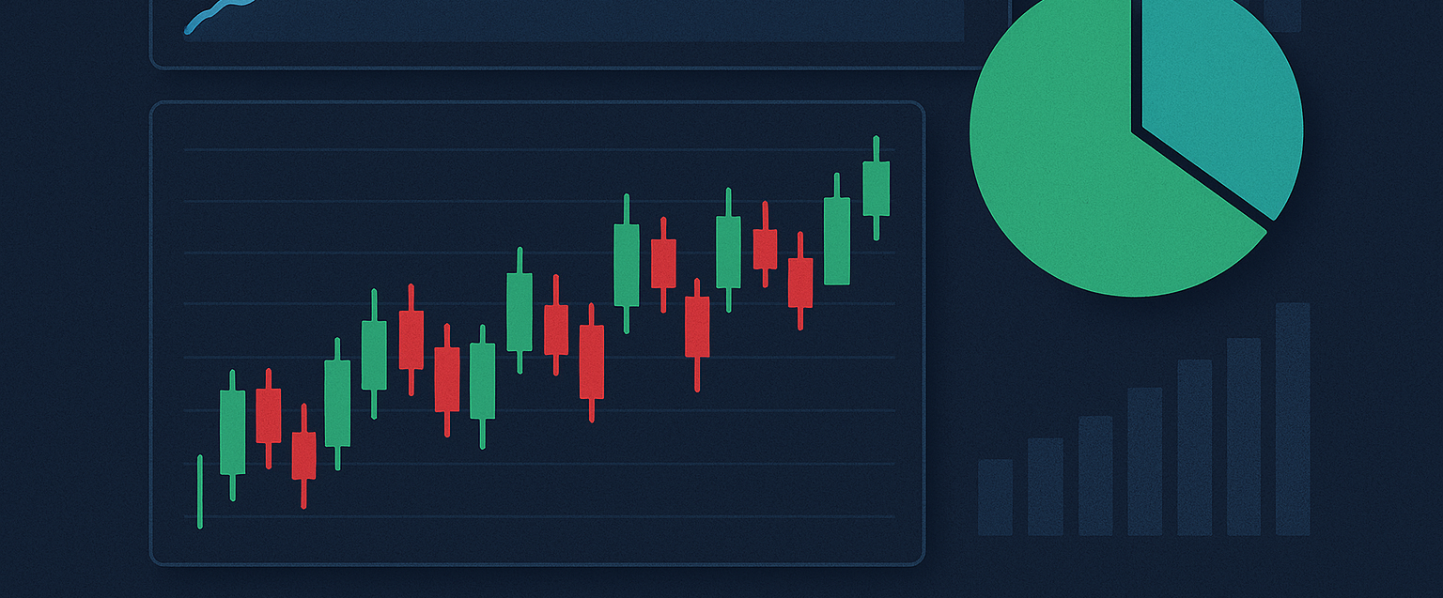
Data-Driven Stock Analysis
Organizing, Cleaning, and Visualizing Nifty 50 Market Trends

Slide 2
Project Overview & Objectives

Slide 3


Problem Statement & Key Skills
Problem Statement
Key Skills
To provide a comprehensive analysis of Nifty 50 stocks by processing daily data, generating key performance insights, and creating interactive dashboards to help investors, analysts, and enthusiasts make informed decisions.
Tools: Python, Pandas, SQL, Streamlit, Power BI
Techniques: Data Organizing, Data Cleaning, Data Visualization, Statistical Analysis
Domain: Finance / Data Analytics

Slide 4
Business Use Cases
Stock Performance Ranking: Identify the top 10 best-performing (green) and top 10 worst-performing (red) stocks over the past year.
Market Overview: Provide a market summary with average stock performance and insights into the percentage of green vs. red stocks.
Investment Insights: Help investors quickly identify stocks with consistent growth and those with significant declines.
Decision Support: Offer insights on average prices, volatility, and overall stock behavior for traders.

Slide 5
Our Project Workflow

Slide 6
End-to-End Process
2. Analysis
4. Delivery
Calculated key metrics: Volatility, Cumulative Returns, Sector Performance, and Correlation.
Delivered a complete solution with clean data, scripts, and accessible dashboards.
1. Data ETL
3. Visualization
Extracted data from monthly YAML files, transformed, cleaned, and loaded into a SQL database.
Built interactive dashboards using Power BI and Streamlit to visualize insights.

Slide 7
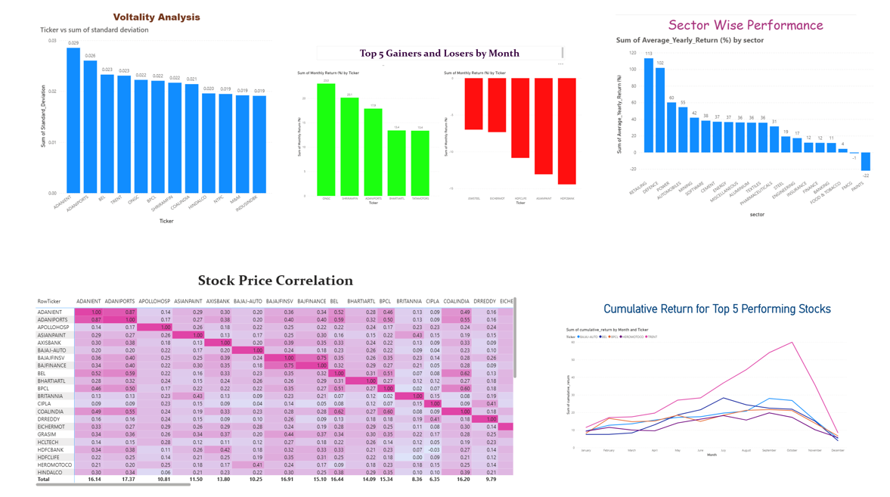
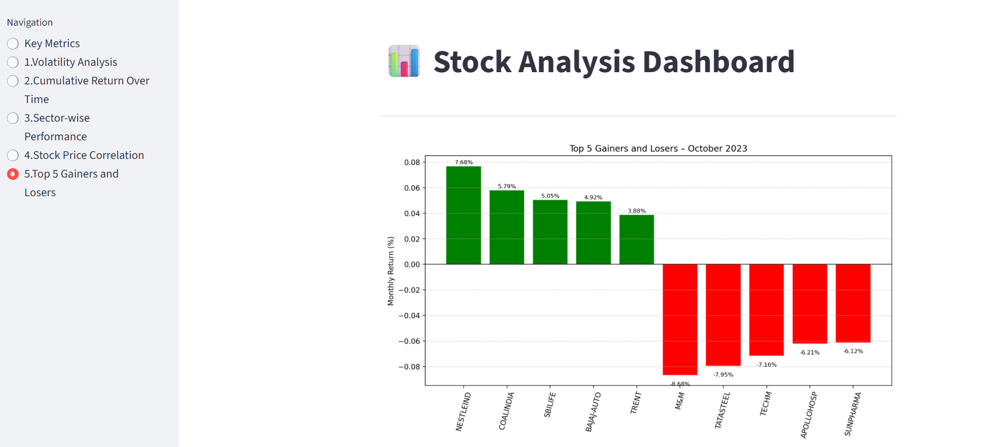


Project Deliverables: Interactive Dashboards
Power BI Dashboard
Streamlit Web App
For high-level visualization of stock performance, trends, and sector-wise analysis.
For real-time, interactive analysis, allowing users to select stocks and view dynamic metrics.

Slide 8
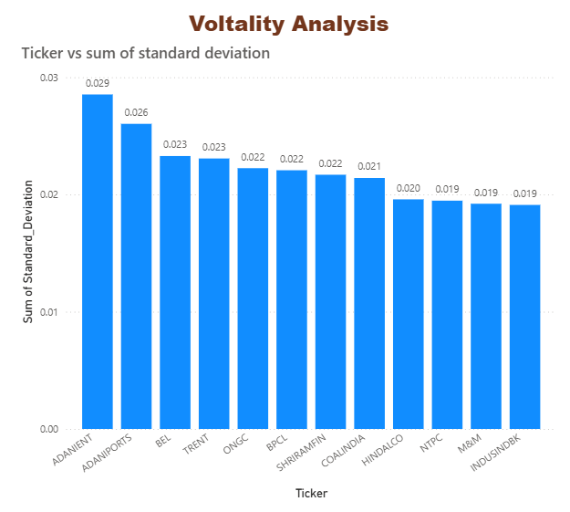
Key Insight: Volatility Analysis
Volatility (std. deviation of daily returns) was calculated to assess risk. This chart highlights the stocks with the most price fluctuation.

Slide 9
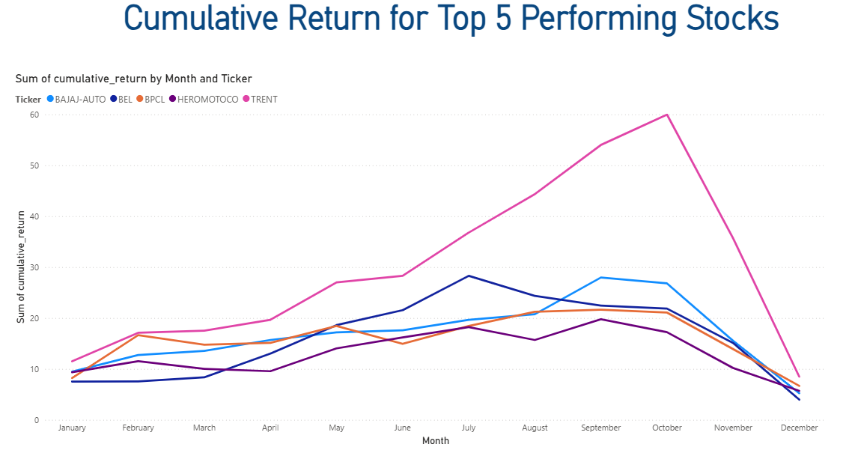
Key Insight: Cumulative Return for Top 5 Stocks
Tracked cumulative returns for the top 5 performing stocks to visualize their overall performance and growth trajectory over the year.

Slide 10
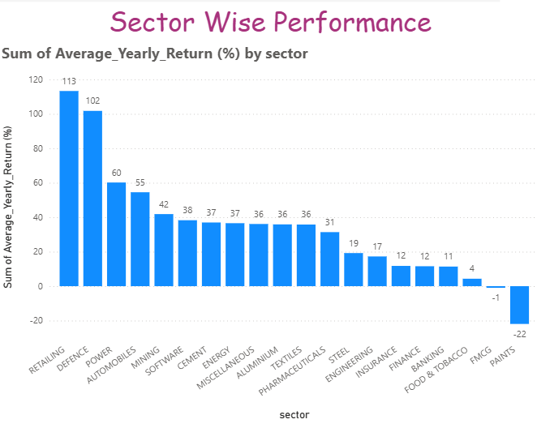
Key Insight: Sector-wise Performance
Calculated the average yearly return for each sector to gauge market sentiment in specific industries.

Slide 11

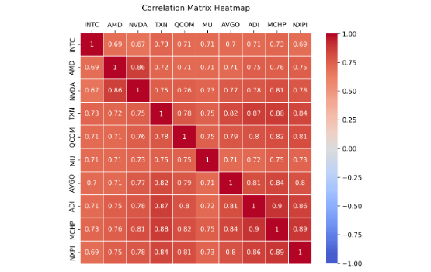
Key Insight: Stock Price Correlation
Understanding Relationships
A correlation matrix was generated using the daily percentage change in closing prices for all stocks.
This heatmap visualizes the relationships between stocks.
- Strong Positive (Blue/Purple): Stocks that tend to move in tandem.
- Strong Negative (Dark Red): Stocks that move in opposite directions.
This analysis is valuable for diversification and understanding sector-wide movements.

Slide 12
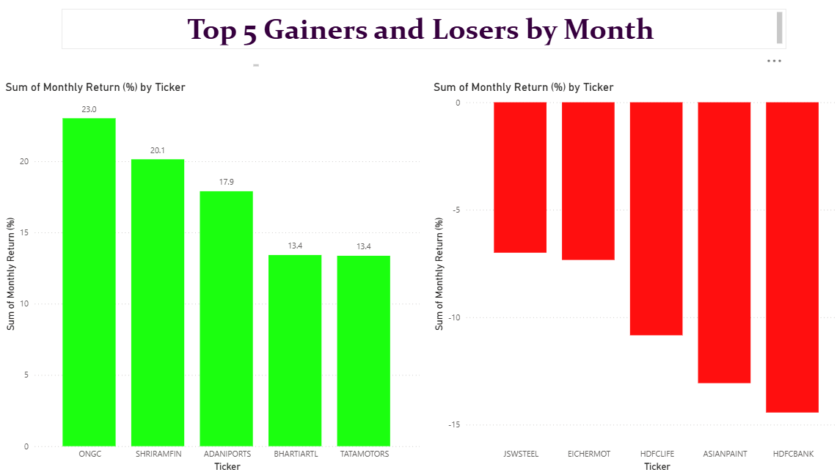
Key Insight: Top 5 Gainers and Losers by Month
Who Won the Month? This chart clearly shows our top performers (the long positive bars) for the month of January 2024, identifying the stocks with the strongest short-term growth.
Immediate Ranking: It acts as an instant leaderboard, letting us rank every Nifty 50 stock based on its monthly return.
Identifying Laggards: Just as important, the negative (red) bars instantly flag the stocks that underperformed and dragged the market down during January.
Momentum Check: The chart is a momentum indicator. Strong positive returns suggest market confidence or positive news catalysts affecting those specific stocks.

Slide 13





Technical Stack
Languages & Libraries
Database
Visualization Tools
A MySQL/PostgreSQL database was used to store the clean, processed, and transformed stock data, ensuring efficient querying and data integrity.
Power BI was used for the main summary dashboard, while Streamlit was implemented to create an interactive, real-time web application for dynamic analysis.
Python was the core language, supported by Pandas for data manipulation, Matplotlib/Seaborn for static plots, and SQLAlchemy for database interaction.

Slide 14
Thank You
Questions?

